Slide 1

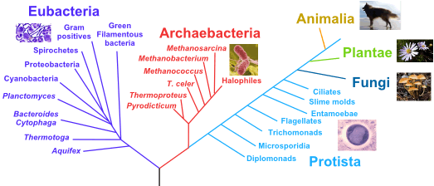
The Basics of Synbio

Slide 2

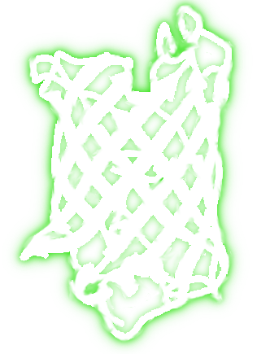
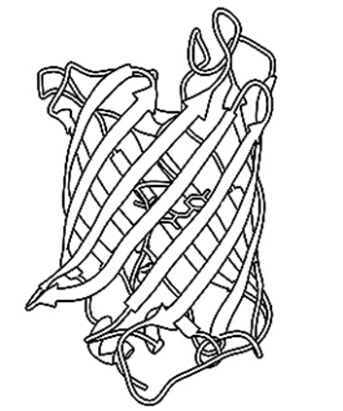
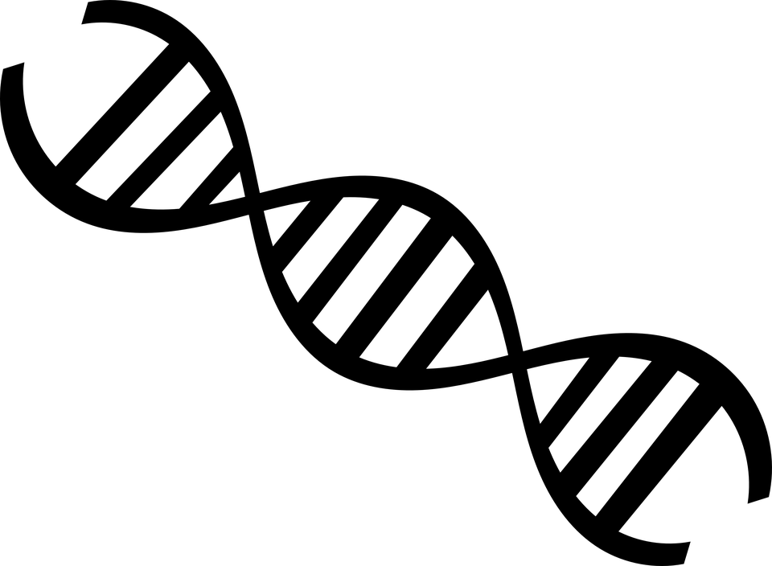
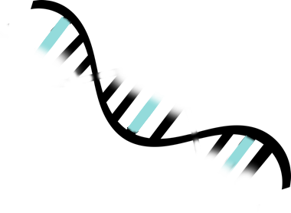

The Central
of Biology
Transcription
Translation
DNA-> RNA -> Protein
(With only a few minor Exceptions)

Slide 3
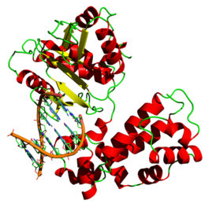
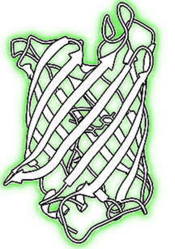
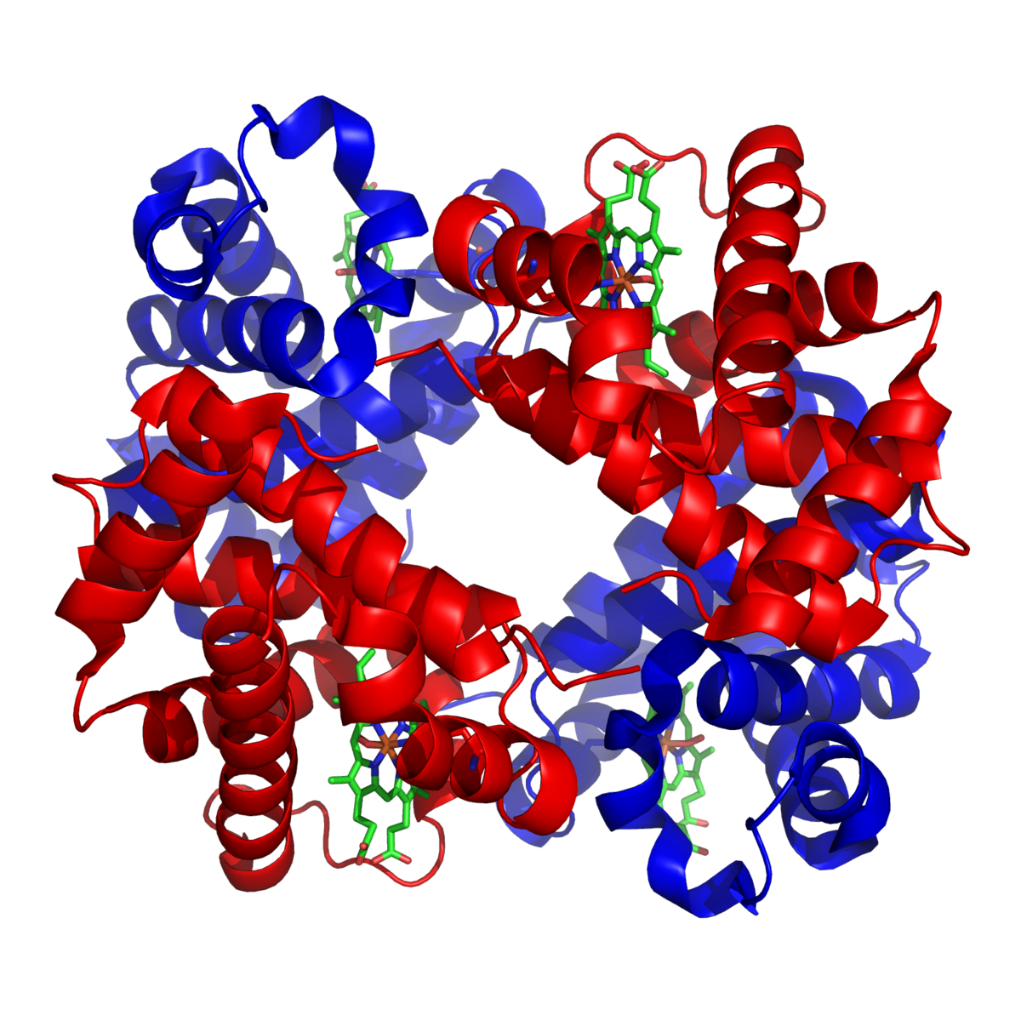
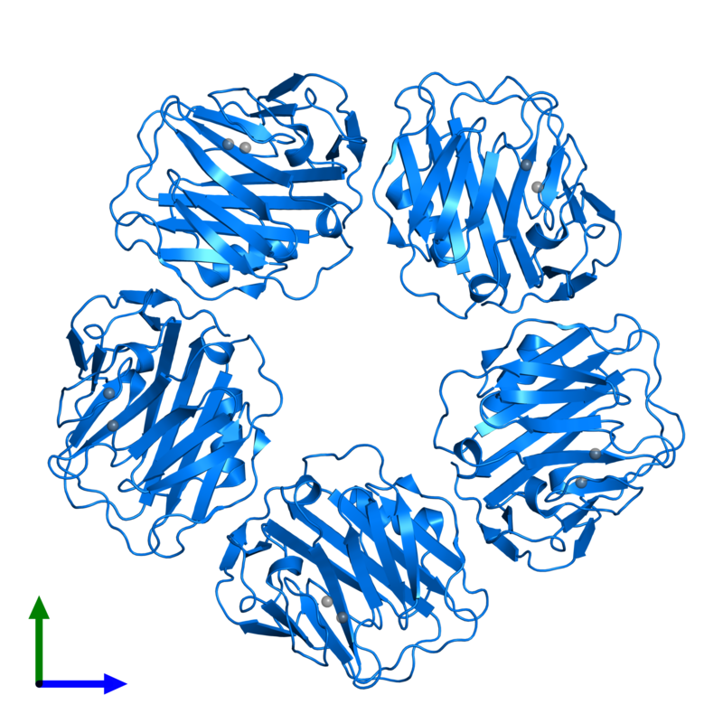
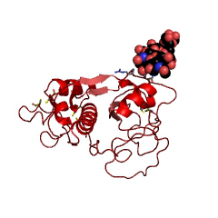

Proteins… Like muscles and stuff right?
Sooo...
What do proteins do?

Slide 4
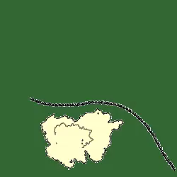
RNA -> Protein

Slide 5

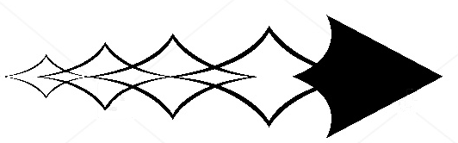
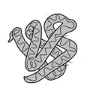
What makes Genes Work?
Promoter
Gene of Interest
Terminator
mTurqoise
-Regulators-

Slide 6


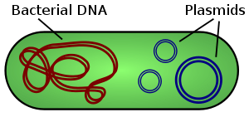
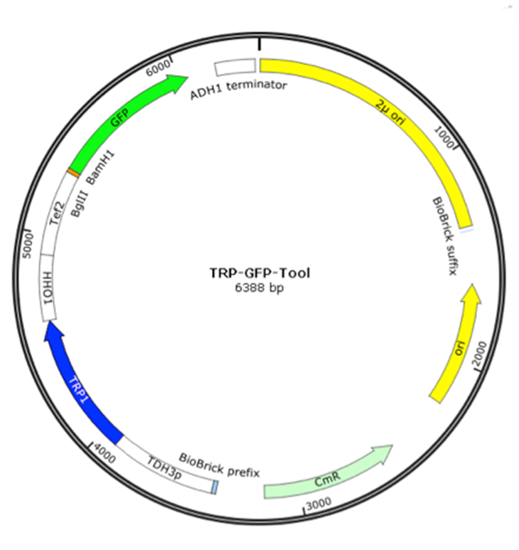
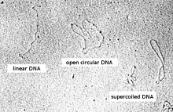
A plasmid is a circular unit of DNA found naturally in bacteria as well as some species of eukaryotes. Plasmids are unique because they are able to replicate independently from chromosomal DNA.

Slide 7

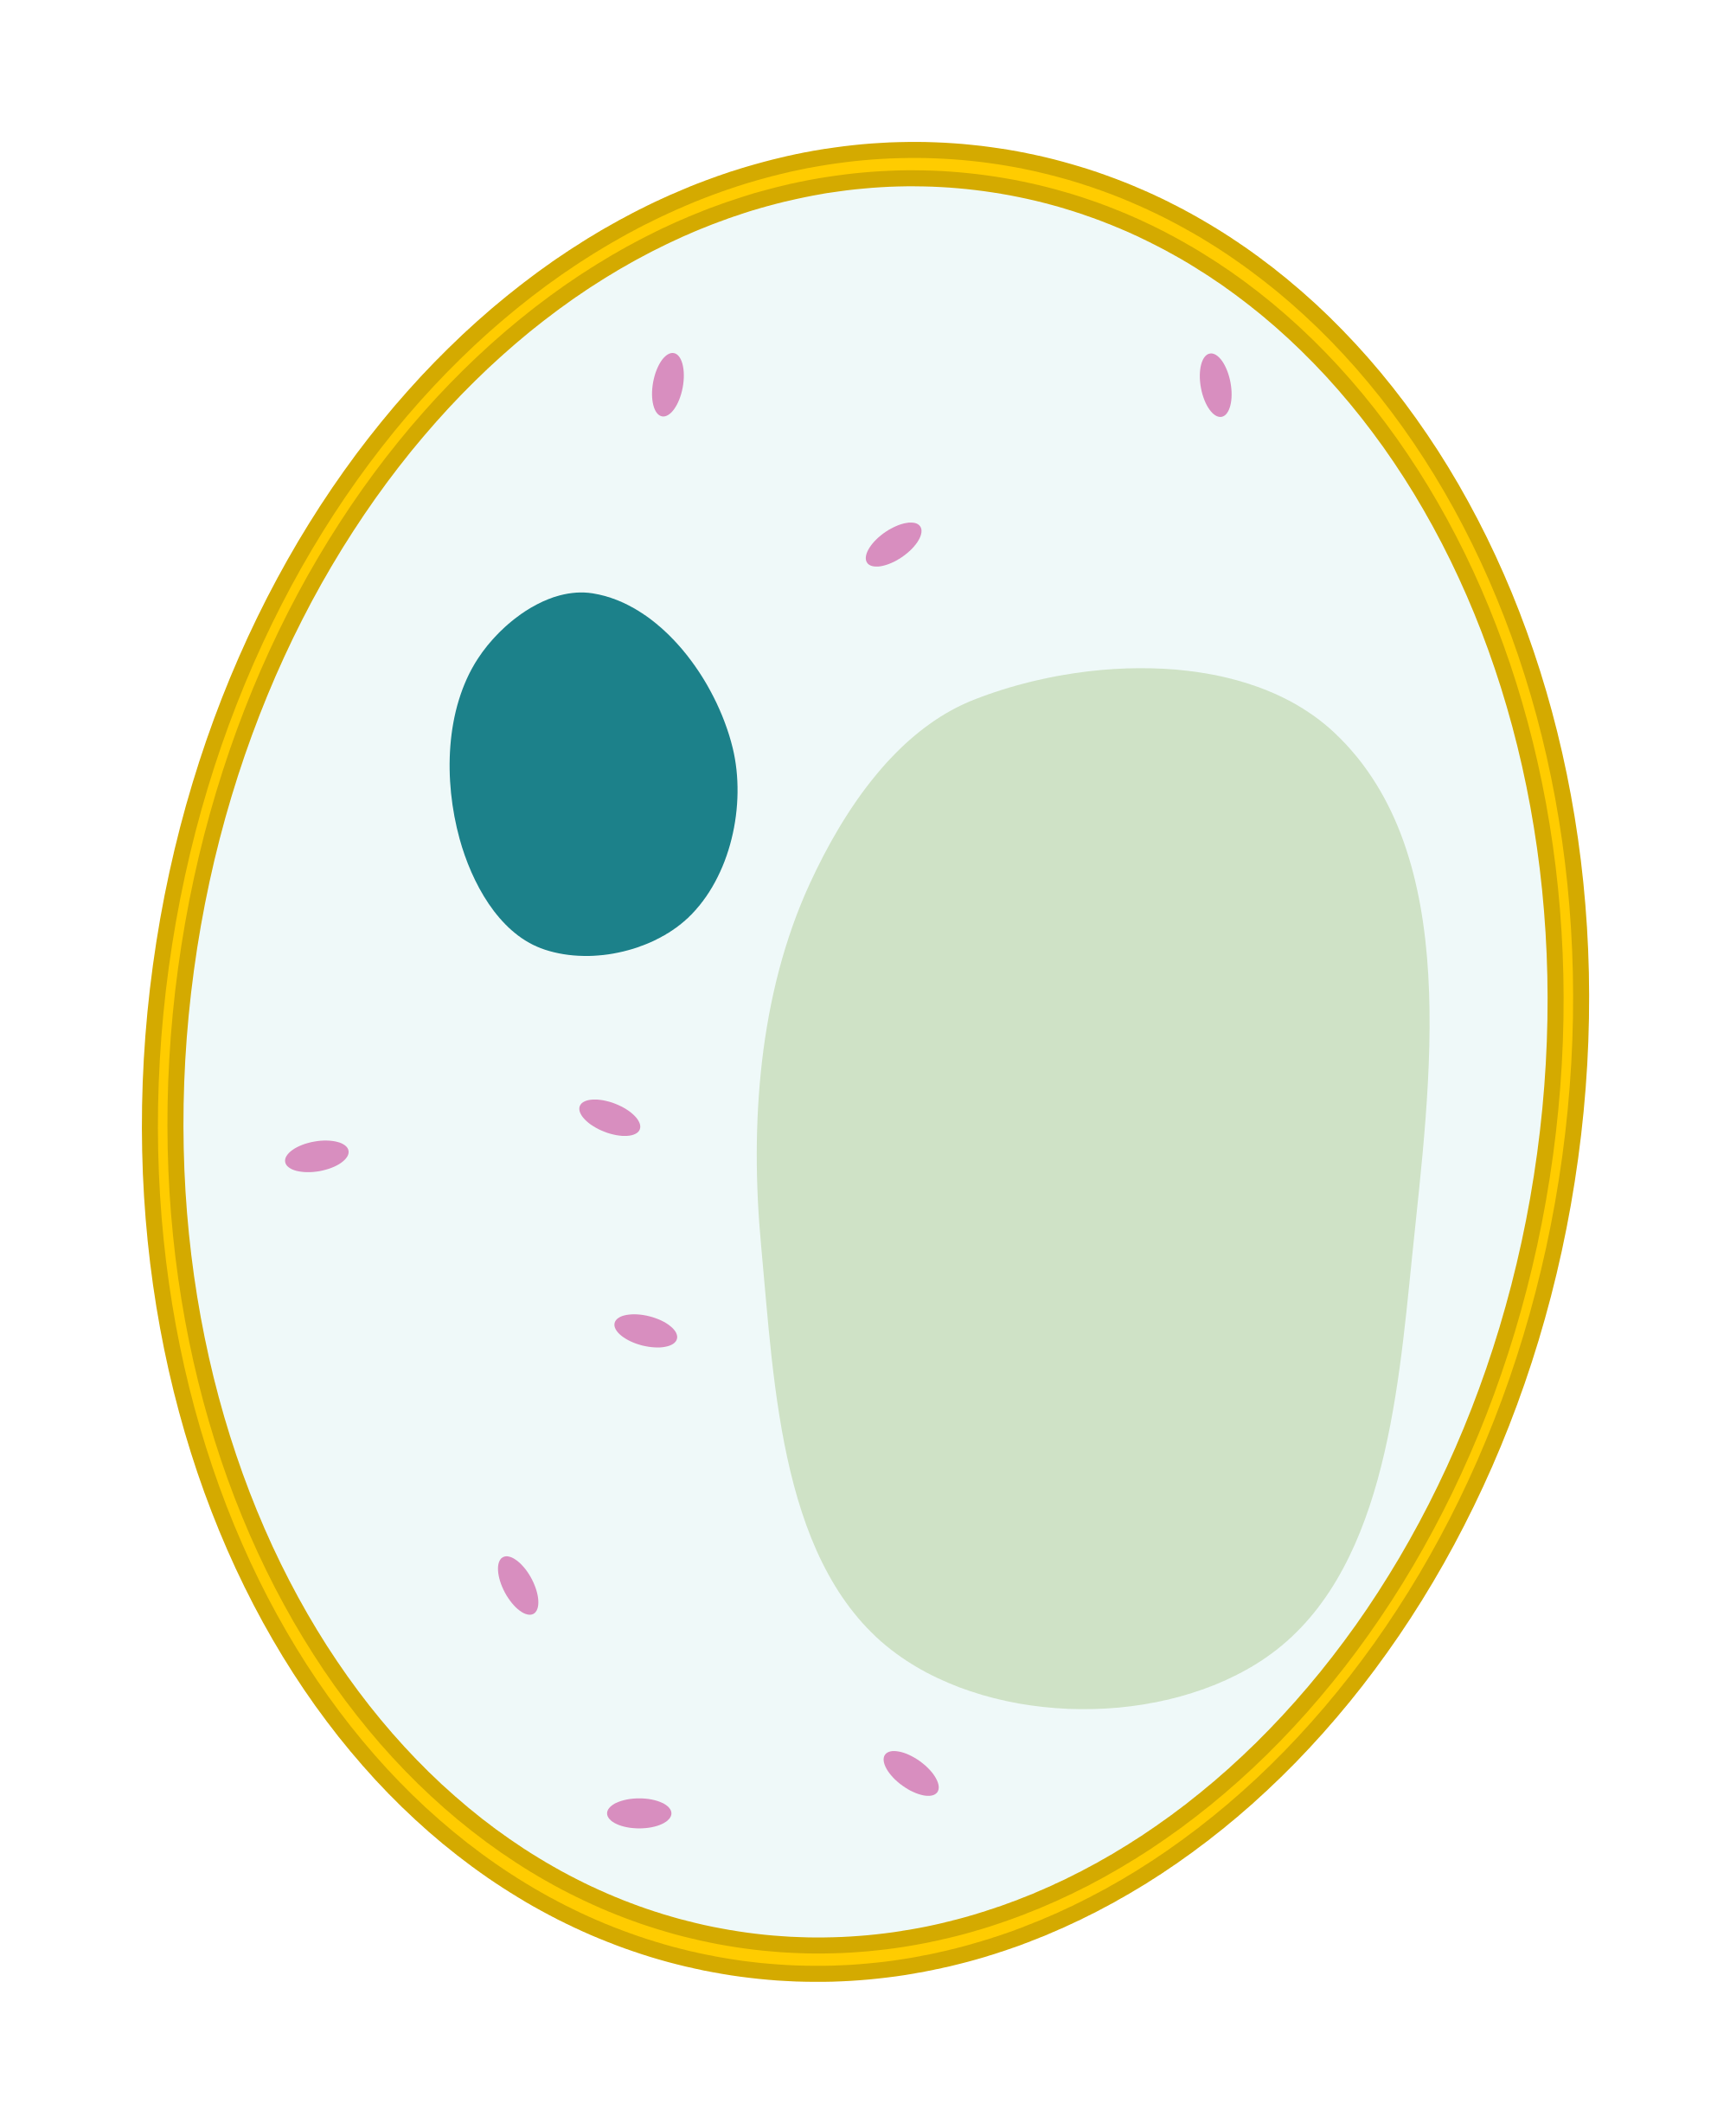
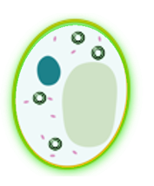


Plasmids are the vector we use to introduce foreign DNA into organisms. The process we use for yeast and e. coli is called “Transformation”

Slide 8
The Plasmid Design Checklist:
Origin of Replication (Ori),
Gene of interest (GOI),

Slide 9
Continued…
Selection Marker
Optional: Homology Regions

